Slide 1
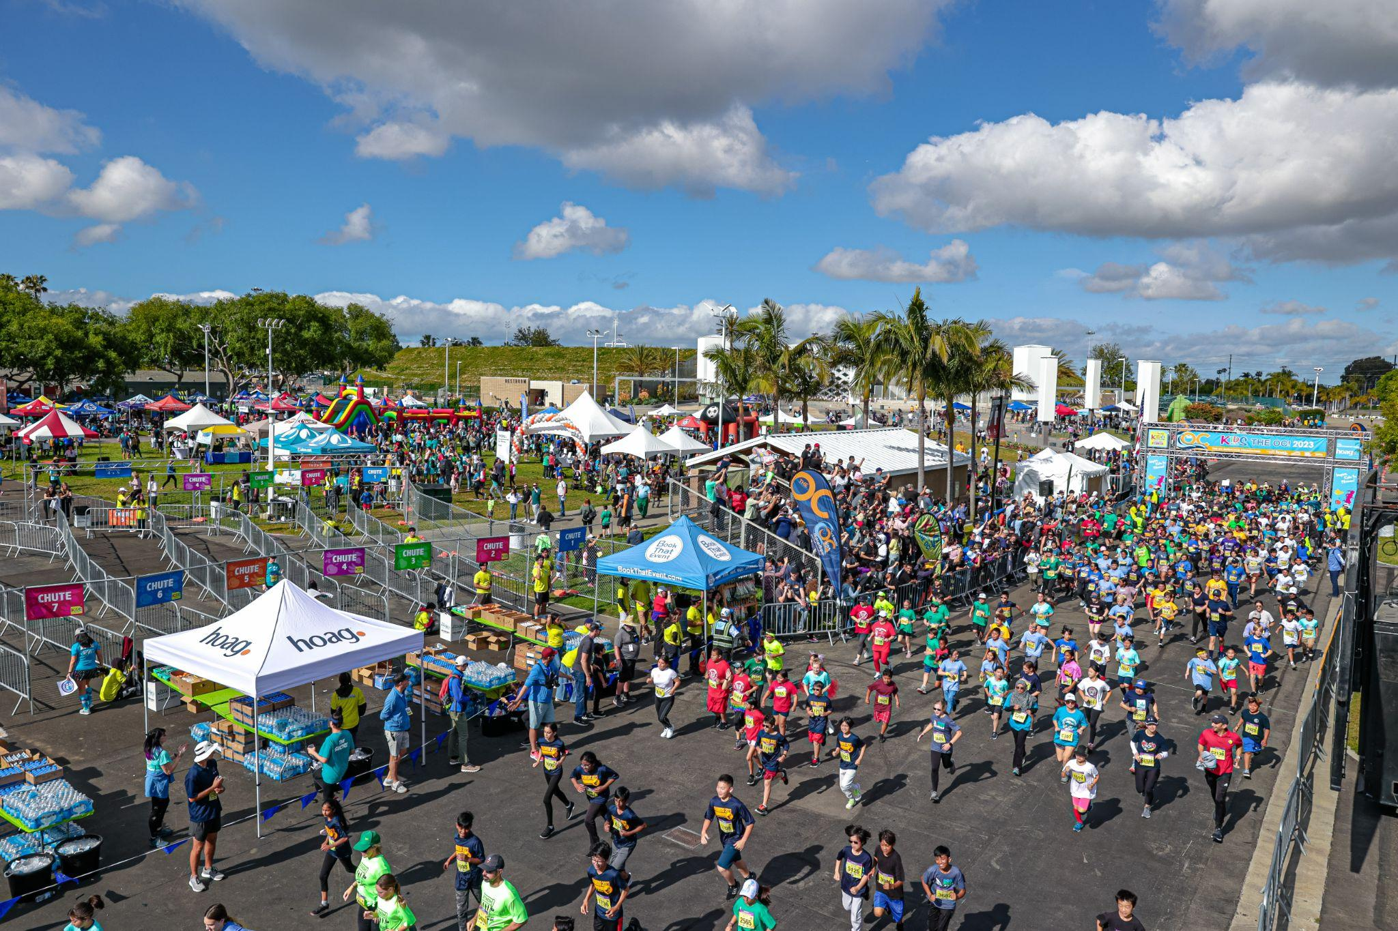
2024 KROC PARENT PRESENTATION
[INSERT TEAM NAME]
Notes:
Kelsey

Slide 2
WELCOME!
Please view this presentation in its entirety.
Our program relies greatly on our parent volunteers and parental support at home. We recommend saving it to your computer for future reference. We know your time is valuable, which is why we opted for an online slideshow, instead of scheduling an in-person Parent Night.
Again, thank you for your time!
Notes:
Kelsey
Main Ideas:
Schools will introduce themselves in order to put faces to names and make them feel more comfortable at training
New Schools – Number of new schools, We hope we can ease your nerves by helping learn whatever your nervous about.

Slide 3
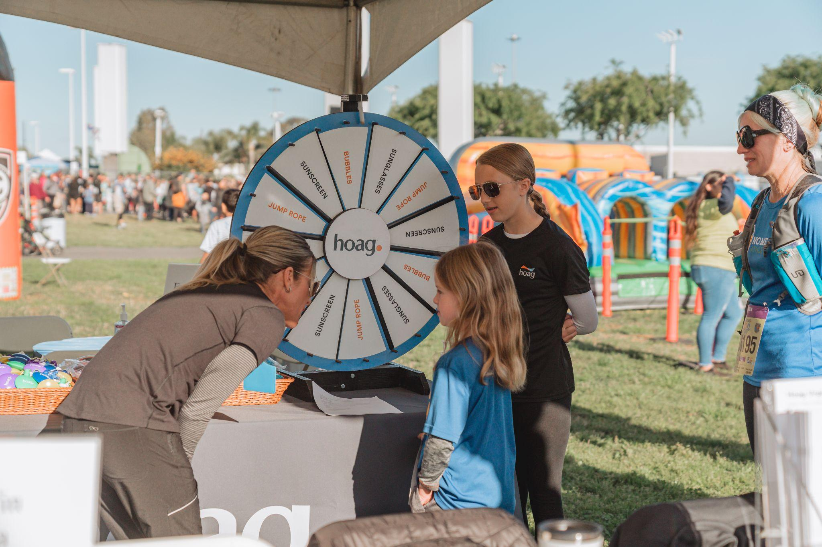
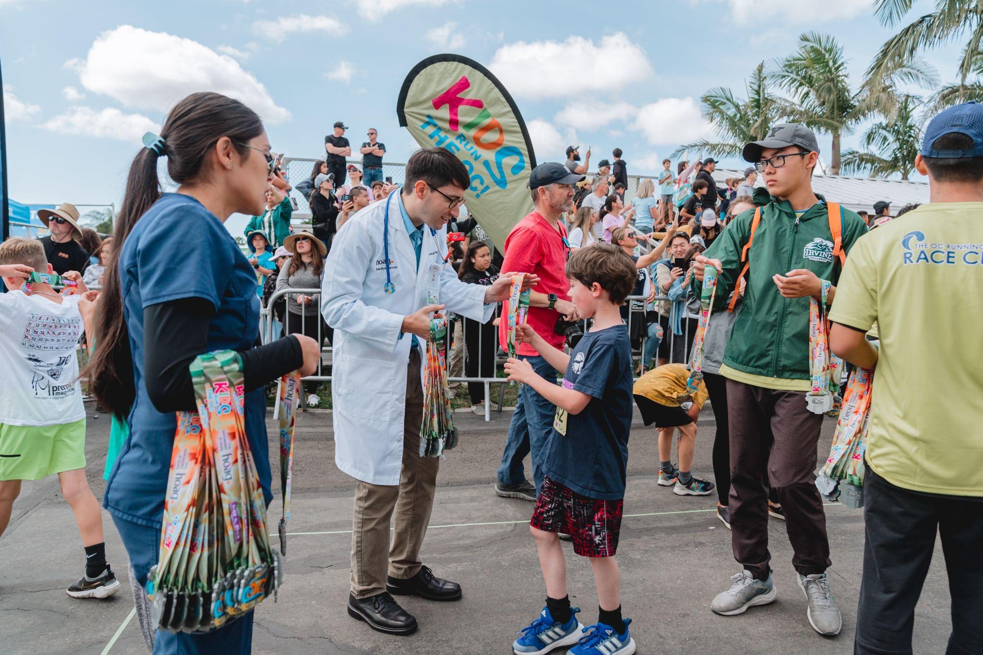
THANK YOU TO THE KIDS RUN TITLE SPONSOR:
Notes:
Kelsey
Main Ideas:
Depending on your calendar 10 weeks should allow you to begin the week of Feb. 13th
This gives “Ski Week” if you have it and Spring Break
If you only have one week off you can begin Feb. 20th
Talk about how each practice has a card.
You can do it exactly like this – or make up your own program. Some schools only choose to do 1 day of practice with KROC homework to complete 25.2 miles.

Slide 4
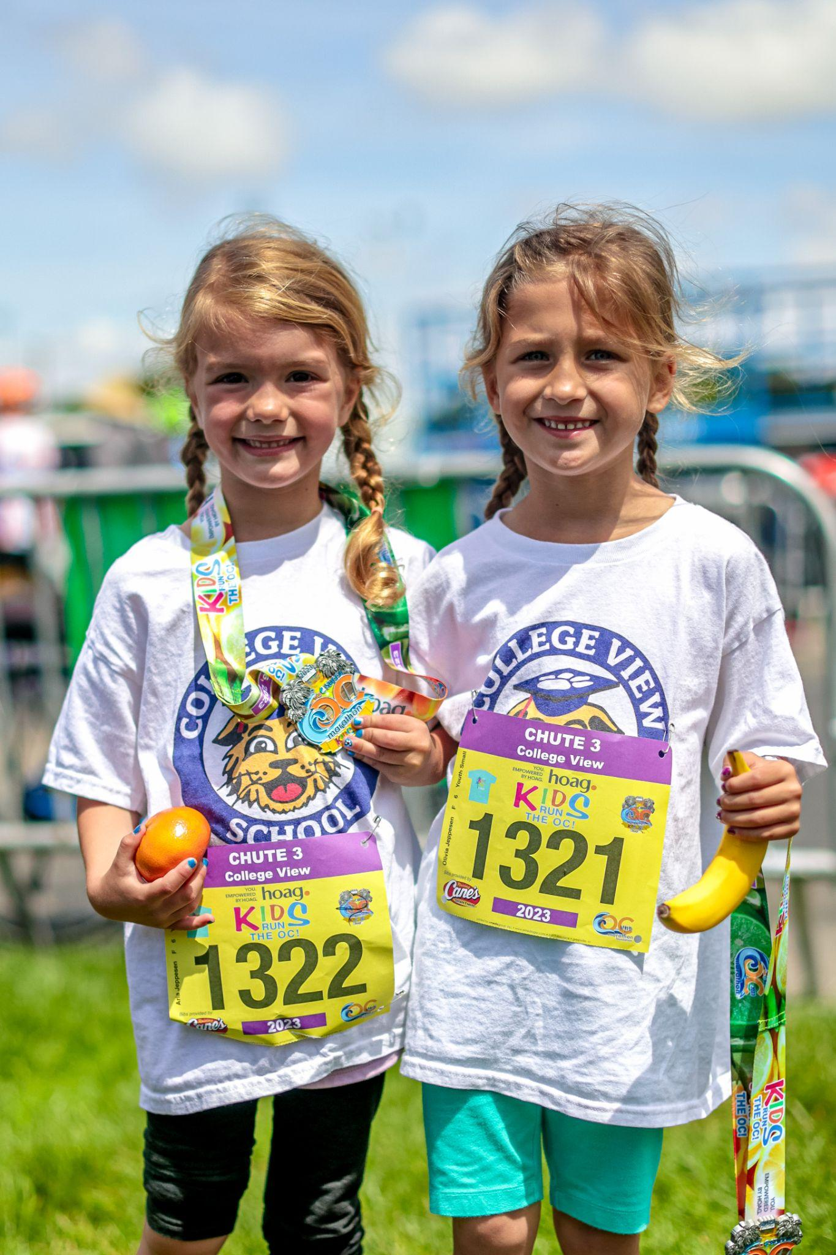
HOW TO STAY CONNECTED
Read our weekly emails.
"Like us" on Facebook and read postings/discussions.
Follow us on Twitter and Instagram.
Check our website often for updates. [Insert Team Name] new FAQ page may answer a lot of your questions.
Attend trainings to support and have fun with your child. It's great seeing the students in action!
Read the weekly Nutritional Newsletter sent home at each training.
Notes:
Presenter: Adrienne
Main Ideas
KROC’s goals are to combat the onset of childhood obesity
Childhood obesity is an epidemic in Orange County that needs a cure
KROC attempts to be that cure – Like a medicine – dosage, time period, etc.
Think about it as a prescription for the disease -- For 10-12 weeks, you are providing 8-10 hours of MVPA (Moderate to Vigorous Physical Activity) , through 20-24 Sessions
Etc., Etc.

Slide 5
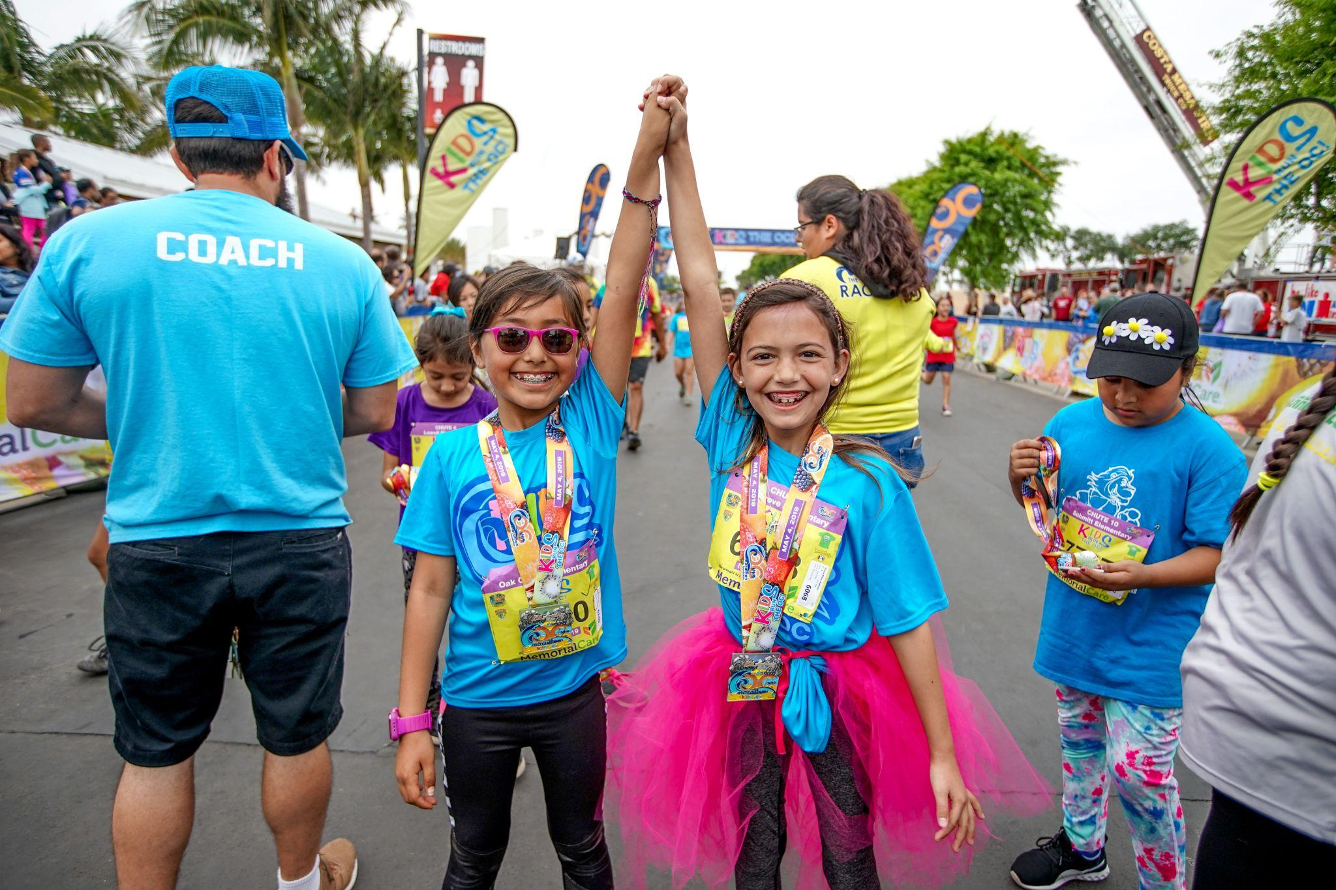
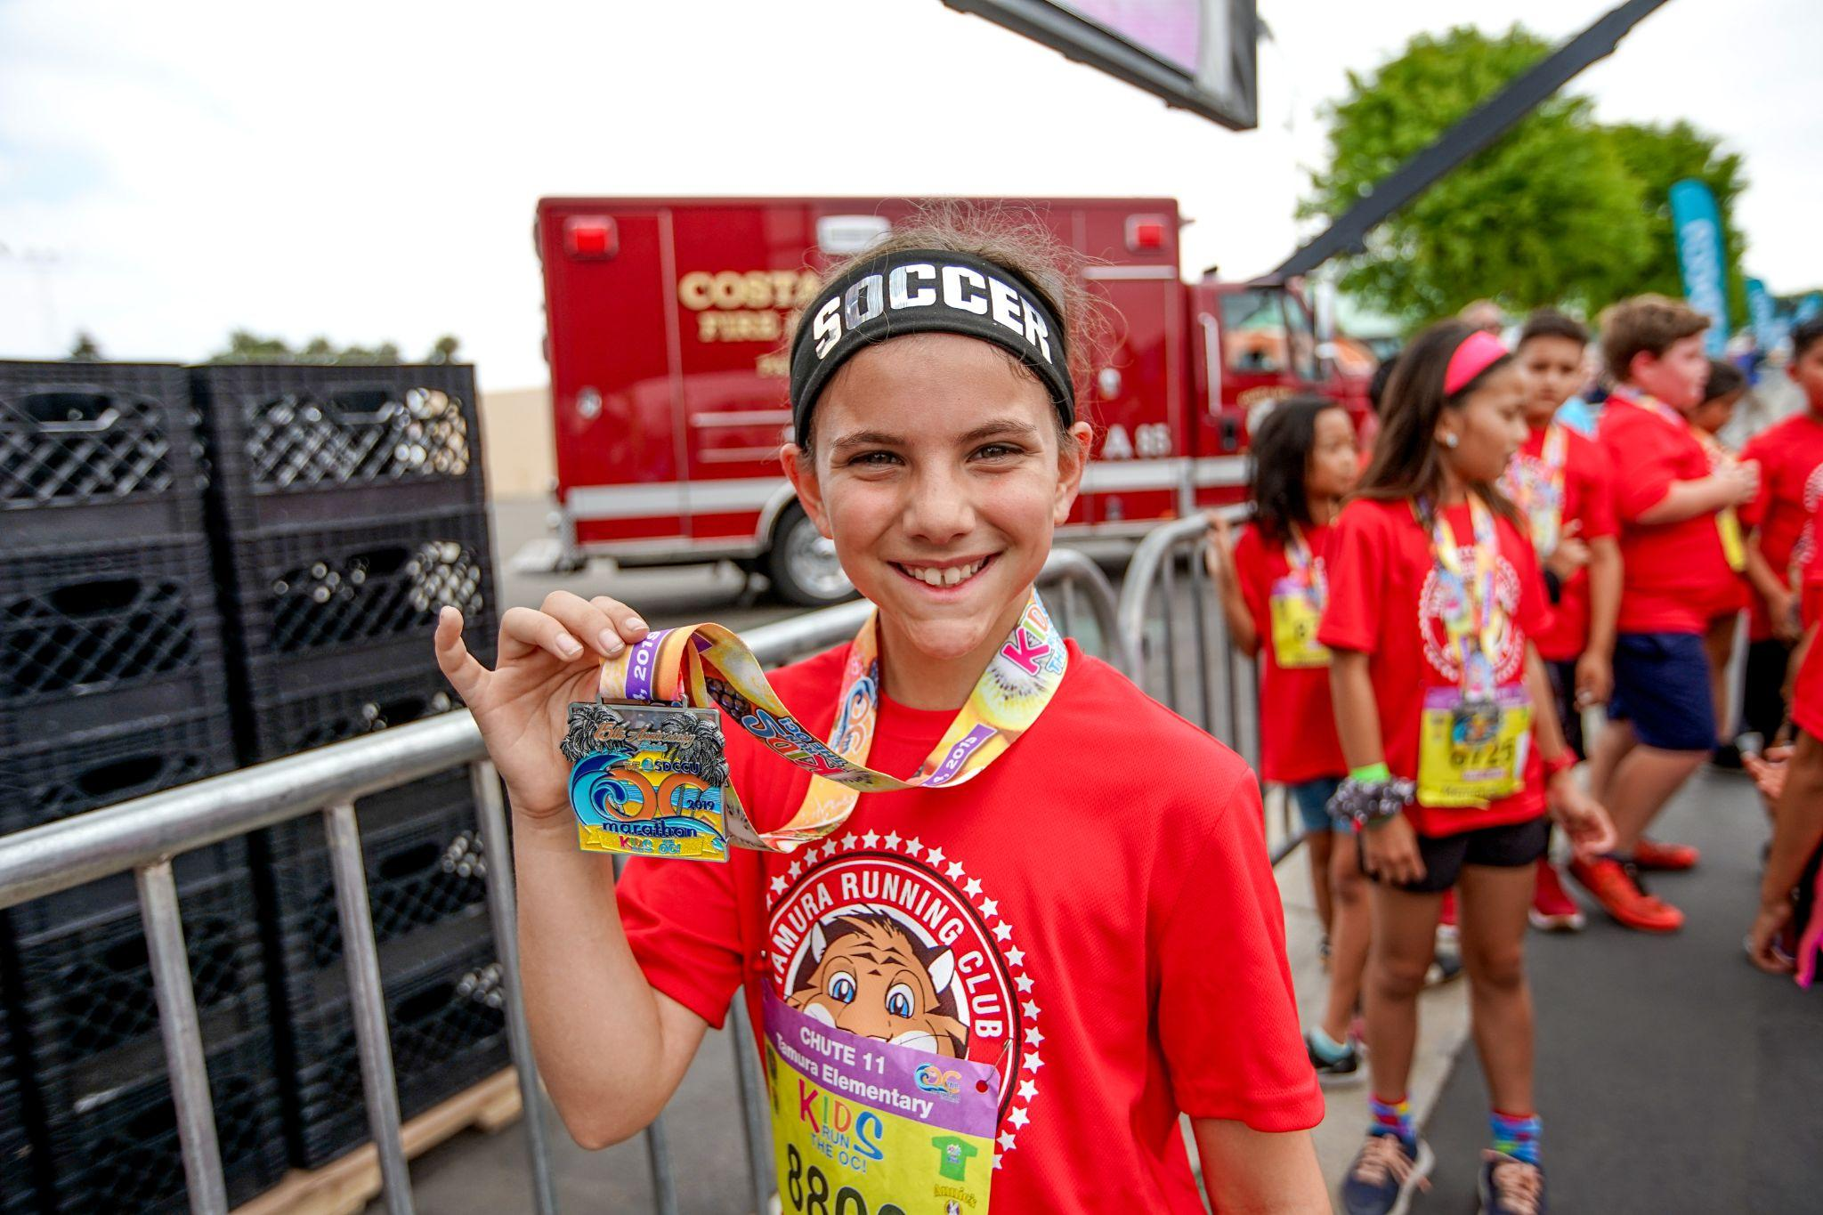
PROGRAM BASICS
Training is every [Insert Training Days and Times]
Trainings are approximately [Insert Time Length] long. Your child will not be released without a parent.
Students are required to check-in and out at the [Insert Meeting Location] at EVERY training.
Parents, please do not check-in or check-out your child. This is to uphold the highest level of safety for your child. Please have your child check themselves out.
We ask for parents to pick their child up AT [Insert Pick-Up Location].
Notes:
Kelsey
Main Ideas
KROC’s goals are to combat the onset of childhood obesity
Childhood obesity is an epidemic in Orange County that needs a cure
KROC attempts to be that cure – Like a medicine – dosage, time period, etc.
Think about it as a prescription for the disease -- For 10-12 weeks, you are providing 8-10 hours of MVPA (Moderate to Vigorous Physical Activity) , through 20-24 Sessions
Etc., Etc.

Slide 6
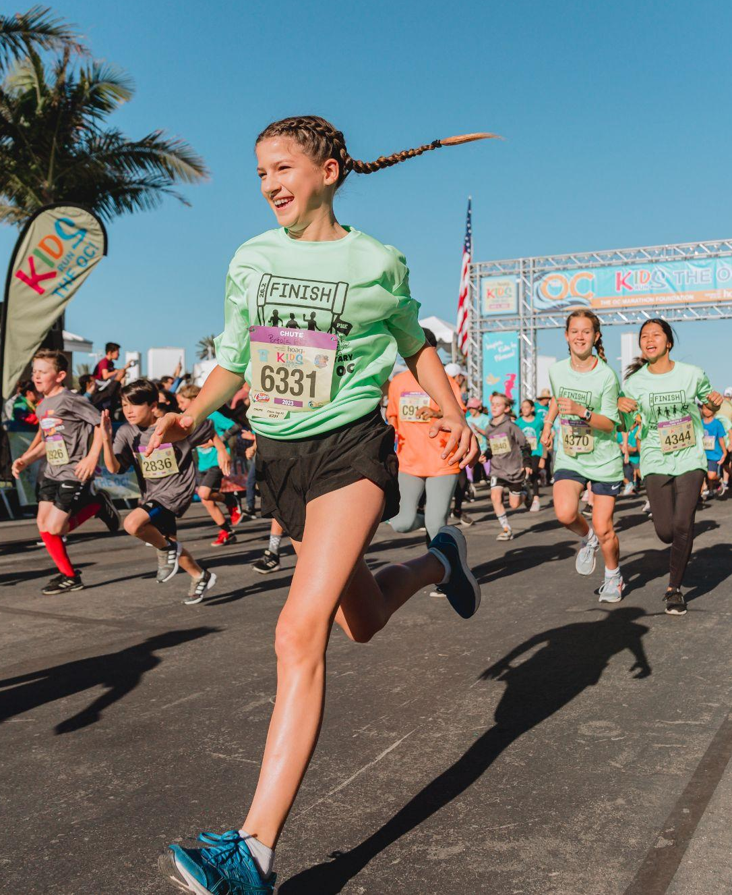
PROGRAM BASICS (CONT.)
Kindergarten and First Grade students must be accompanied by a parent for the entire training. [Optional, but recommended if you have little ones]
For parents who have a primary and upper grade student, please pick up your primary student at the end of the primary training. Do NOT have your primary child wait unattended until the end of the upper-grade training. Thank you in advance for ensuring each child’s safety!
If it is raining, please check your e-mail often throughout the day. [Insert Team Name] will send an email notifying parents if practice is cancelled.
Notes:
Kelsey
Main Ideas:
Pull up Website
Show new forms – recognize that they are different from last year
Day 1 vs. Day 2
Also show KROC Stretch Cards and Explain how they are used.
Over the weekend. Vs. This week etc.

Slide 7
TRAINING CHECKLIST
Running shoes and breathable socks.
2024 [Insert Team Name] T-Shirt or other comfortable t-shirt.
Wear Comfortable pants or shorts. We highly recommend against wearing jeans. They can become very uncomfortable!
Water bottle with name on it.
Small, healthy, easy snack for after school/before training
Signed Nutritional Challenge slip (discussed in a future slide)
Notes:
Kelsey

Slide 8
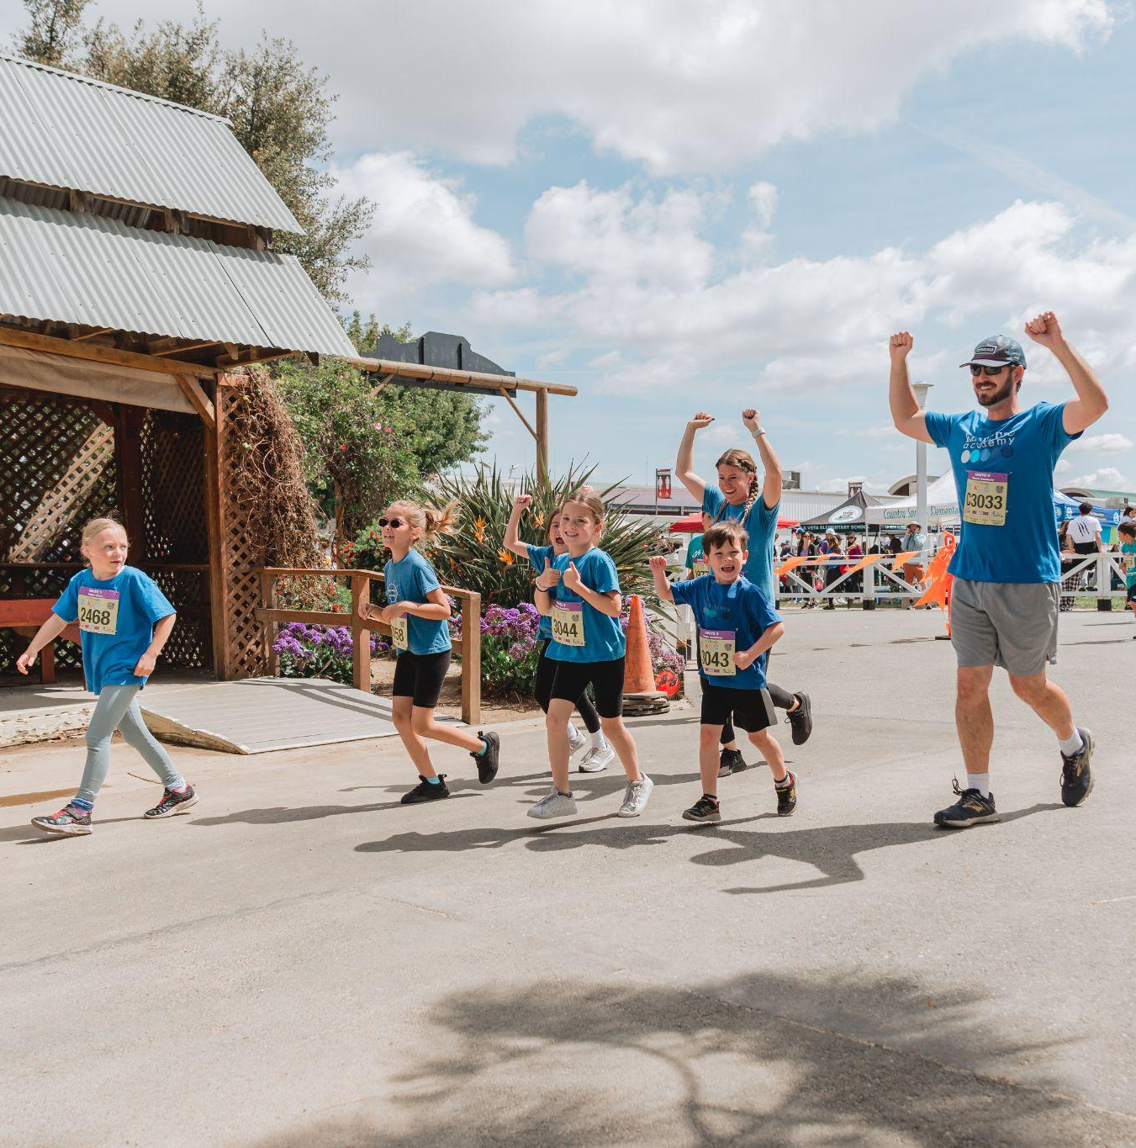
FIRST WEEK “MUST-DO’S”
Remind your child to stay at the [Insert Pick-Up Location] for you to pick them up at the end of each training.
When picking up your child, ask them, “Did you check-out?" as a reminder.
All students will receive our [Insert Team Name] Pledge [with their T-shirts (Optional, if you have a Team T-shirt]. Please sign and turn in at our first training.
Our weekly Nutritional Newsletter will be distributed to students at check-out. These need to be signed and returned at every training for students to be entered in our weekly drawings. Do not turn these in to your classroom teacher.
Notes:
Kelsey
Main Ideas:
Explain that activities are similar but adjusted for Age Level
Frog Hops -> Monster Hops
Animal Tag -> Zombie Tag Etc.
Coaches can pass out training cards from different grade levels to different grade level coaches/ make copies/ etc.
If your group is small you can choose one level but if you have a wide variety of ages you can distribute the correct cards per age group to the practice leaders

Slide 9
COACHING POSITIVE MOTIVATION
Understand the overriding goals of the program
To have fun.
To improve skills.
To learn new skills.
To be with friends and make new friends.
To promote physical fitness.
To build confidence and self-esteem.
Enhance the physical, social and emotional growth of students
Provide an appropriate model for interacting with others.
The model you establish will be emulated by the students.
Emphasize the importance of enjoying practices.
Model ethical conduct.
Exhibit self-control and self-discipline at all times.
Recognize the effect your behavior has on students and volunteers.
Be positive, courteous and considerate when dealing with others.
Notes:
Kelsey
Main Ideas:
Depending on your calendar 10 weeks should allow you to begin the week of Feb. 13th
This gives “Ski Week” if you have it and Spring Break
If you only have one week off you can begin Feb. 20th
Talk about how each practice has a card.
You can do it exactly like this – or make up your own program. Some schools only choose to do 1 day of practice with KROC homework to complete 25.2 miles.

Slide 10
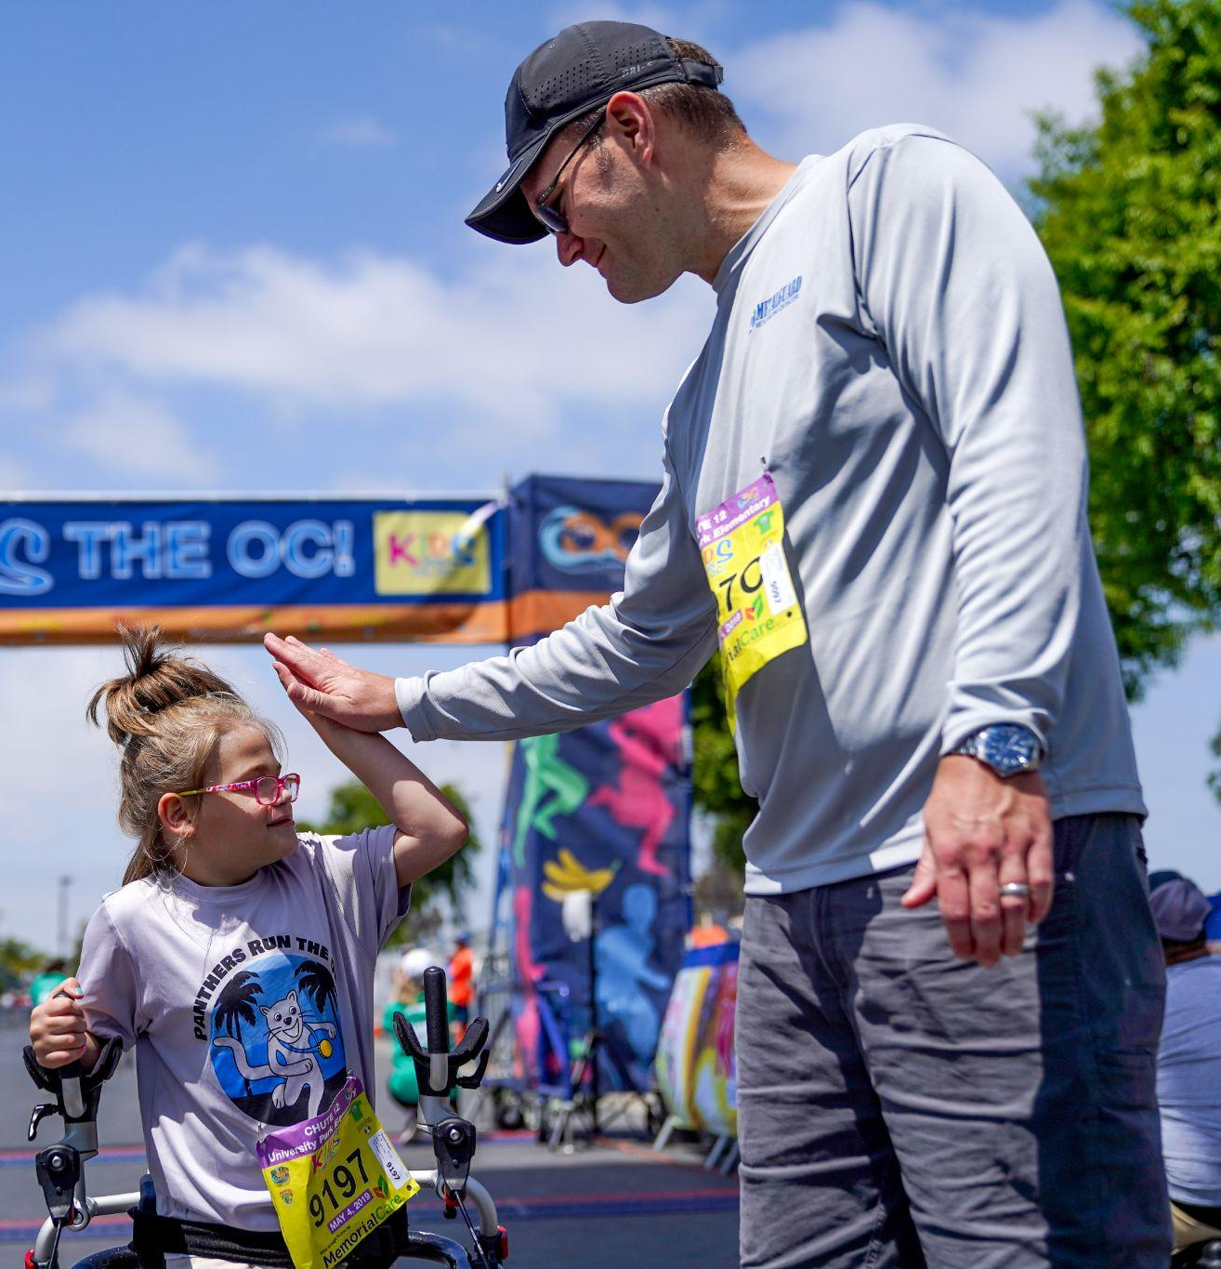
COACHING POSITIVE MOTIVATION (CONT.)
Developing sporting behavior in students.
Develop student respect for coaches and good behavior while interacting with others.
Develop effective motivational skills.
Encourage student self-confidence and self-esteem development.
Show acceptance.
React positively to mistakes.
Give encouragements.
Use positive instructional methods such as specific feedback, specific encouragement and constructive criticism.
Notes:
Kelsey

Slide 11
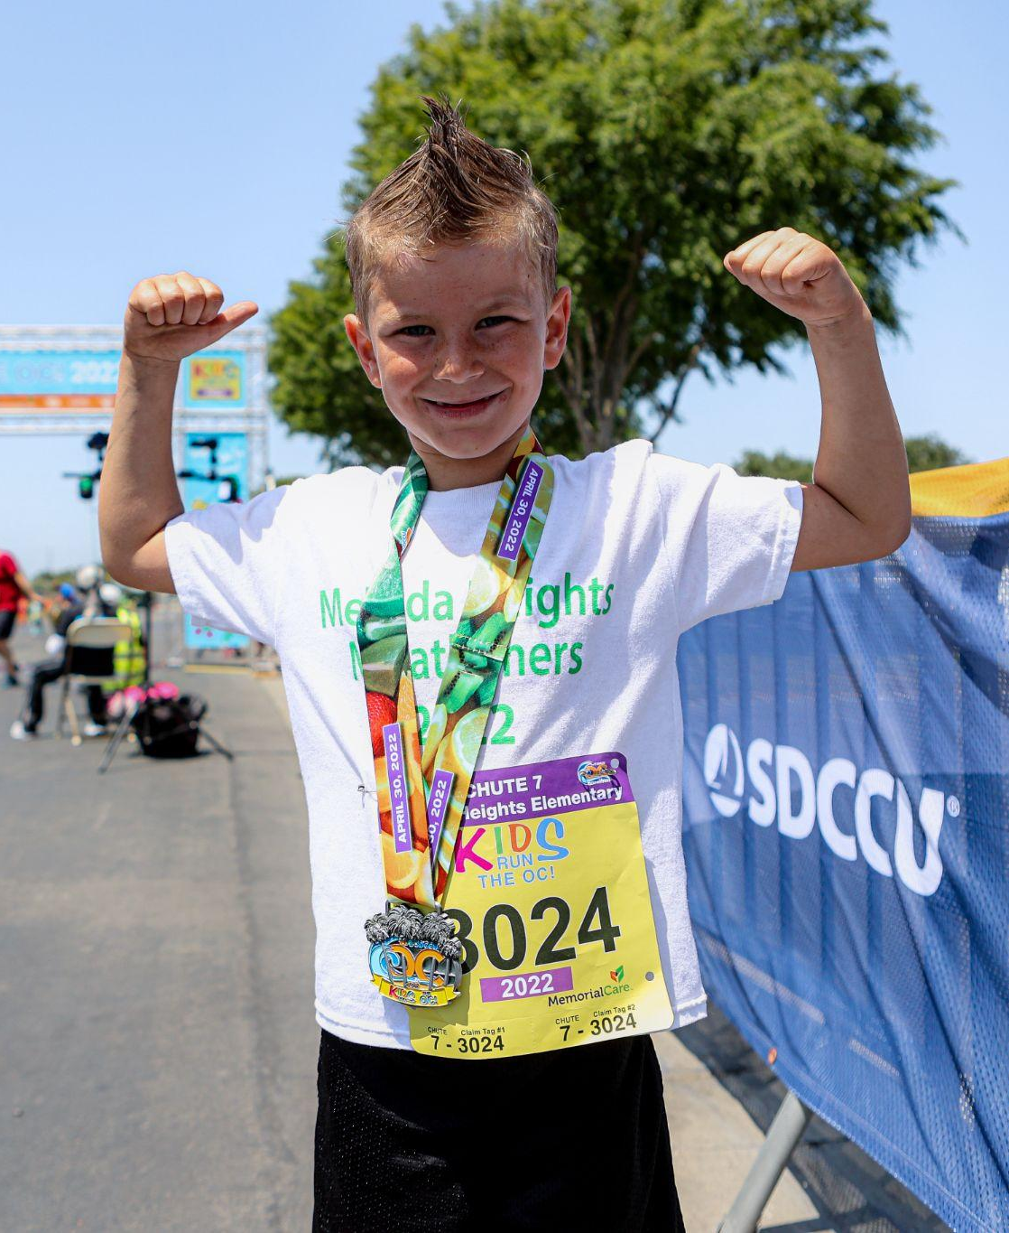
NUTRITIONAL CHALLENGES
Every week [Insert Team Name] assigns a Nutritional Challenge. We discuss it at the training and send it home with your child. Each child is accountable for their Nutritional Challenge. Each week, if they successfully completed the Challenge, they will return the signed slip and be entered in a drawing. Please discuss the reason for the Nutritional Challenge and the importance of completing it.
Notes:
Kelsey
Main Ideas:
Use KROC equipment as props
Note that all different equipment can be purchased on Amazon.com w/ pricing
Go over almost every bullet point
Specifically show Kid Fits Cards, etc.

Slide 12
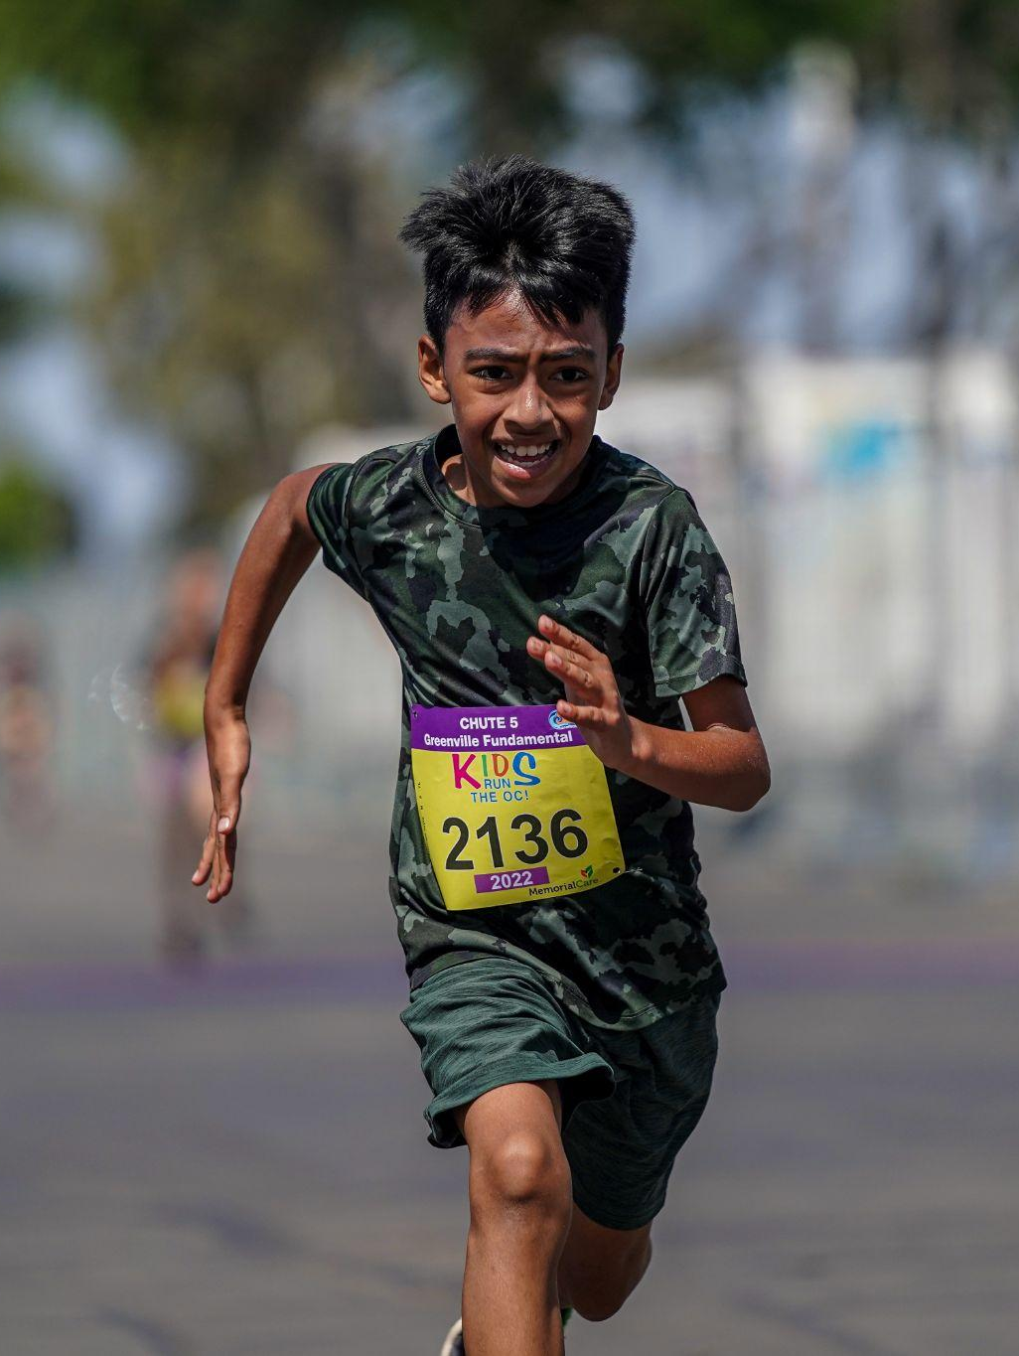
LOGGING MILEAGE
OPTIONAL SLIDE – here you would insert how you plan to have kids log any mileage outside the trainings.
We have a tracking log sample on the Kid Run the OC website as a tool for you to use to have them turn in to you or a parent volunteer. You can find it in the Coaches Corner under Journals & Assessments, it is called “Distance Log”.
Notes:
Kelsey
Main Ideas:
Explain that the program is divided into time sections and can be adjusted based on times of practices etc.
Show that each step for practice is laid out on card and back is designed for visual learners

Slide 13
REGISTERING FOR KROC
Kids Run the OC (KROC) is OC Marathon Kids Run at the OC Fair & Event Center. It is our expectation for every [Insert Team Name] to run at KROC on Saturday, May 4th.
You are responsible for registering your child(ren) for the KROC event. (OPTIONAL if you charge fees: This event is not included in your [Insert Team Name] registration)
Registration is opens in December 2023, and closes March 1, 2024. Visit www.kidsruntheoc.org to register.
Registration for the May 4th KROC event is $29.00 (plus fees) and closes on 03/01/2024.
The school will receive $5.00 refund per online registration after we have registered 30 kids!
Your child will receive a KROC T-shirt, race bib, timing chip, Kids Run the OC Marathon Medal on Event Day and a beautiful Certificate of Completion at a special school assembly.
Notes:
Presenter: Kelsey

Slide 14
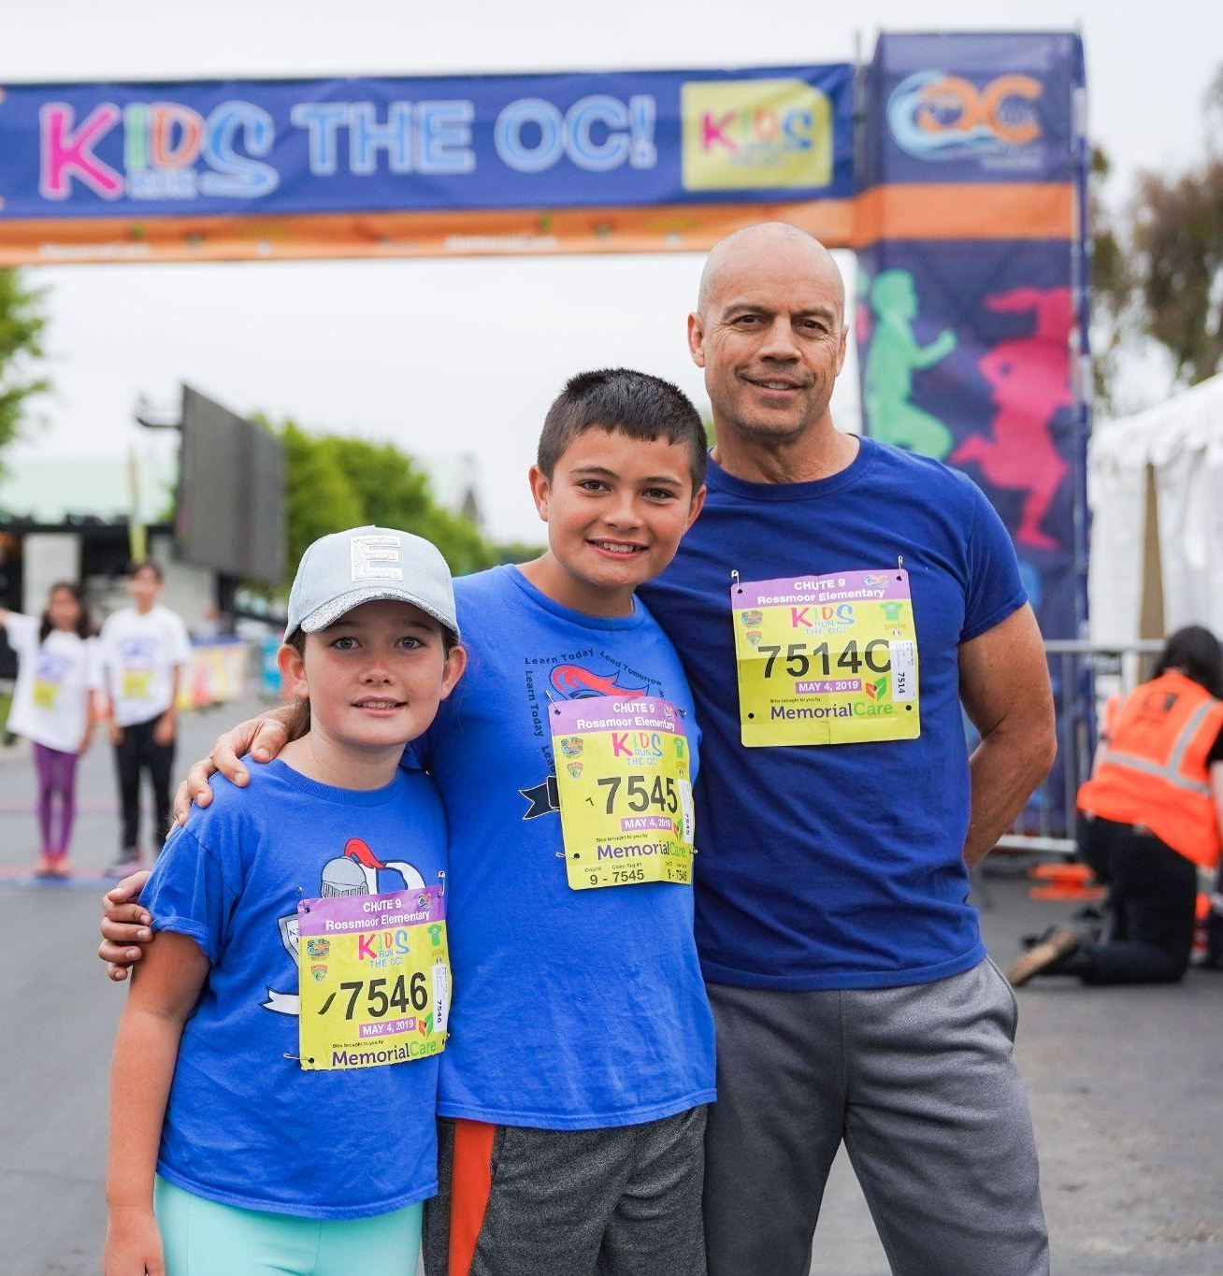
PARENT VOLUNTEER BASICS
Please sign-up on our Parent Volunteer Form so we can schedule our trainings and assign you to your area of interest. If you plan to attend trainings with your child, please sign-up as a volunteer. We always need more volunteers!
If you are unable to attend a training session for which you have signed up, please notify us as soon as possible.
We are always in need of additional volunteers for our upper grade trainings.
Of course, we ask all our parents to model KROC and our school values and use specific positive reinforcement as much as possible.
Notes:
Presenter: Kelsey
Start Time: 10:00 AM
Show website for kids registration -- Done after the flyers are passed out
Kids show up for practice --- Make sure they are registered – Show them how to Use login -- hand out to explain on line management
Example of Waiver in packet which should be signed by every student
Coaches pick up Bibs at Event Day training – Dates to follow during Key Dates section

Slide 15
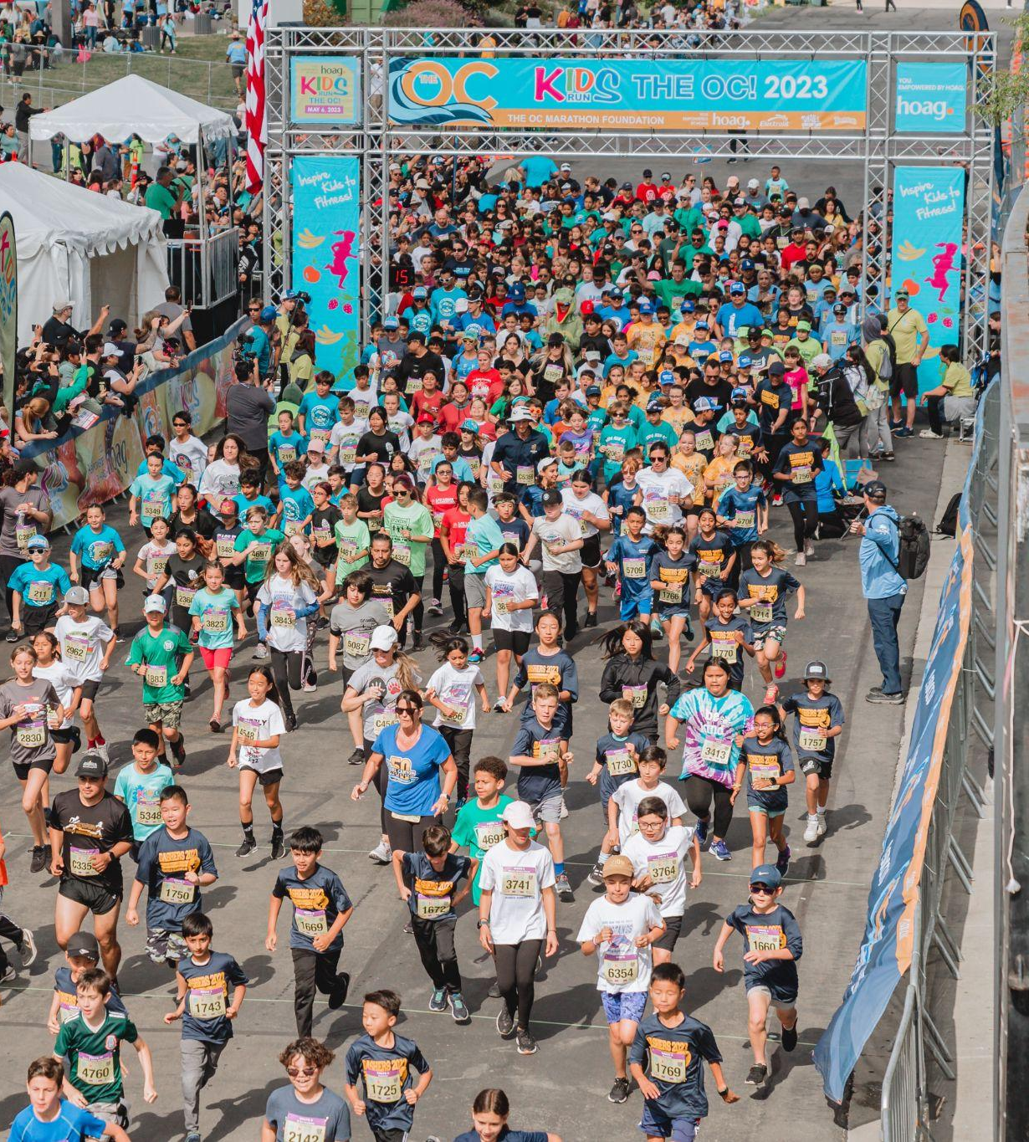
FIRST AID
It is important for all parents to know where to send a child in need of first aid. [Insert Team Name] has a first aid station at the [Insert Location]. For minor injuries requiring a band-aid, ice pack, etc., please escort runners to the [Insert First Aid Location].
OPTIONAL if your school has one. [Insert School Name] also has an Automated External Defibrillator (AED) in the office. All [Insert Team Name] coaches are trained on the AED. In case of emergency, direct a [Insert Team Name] coach or school staff member to get the AED and immediately call 911.
We encourage our parents to attend our trainings with a phone in hand. This is a great safety precaution!
If a child is injured, please notify a coach ASAP. Do not leave the training with your child without notifying a coach (or sending someone to do so in your place).
Notes:
Presenter: Kelsey

Slide 16
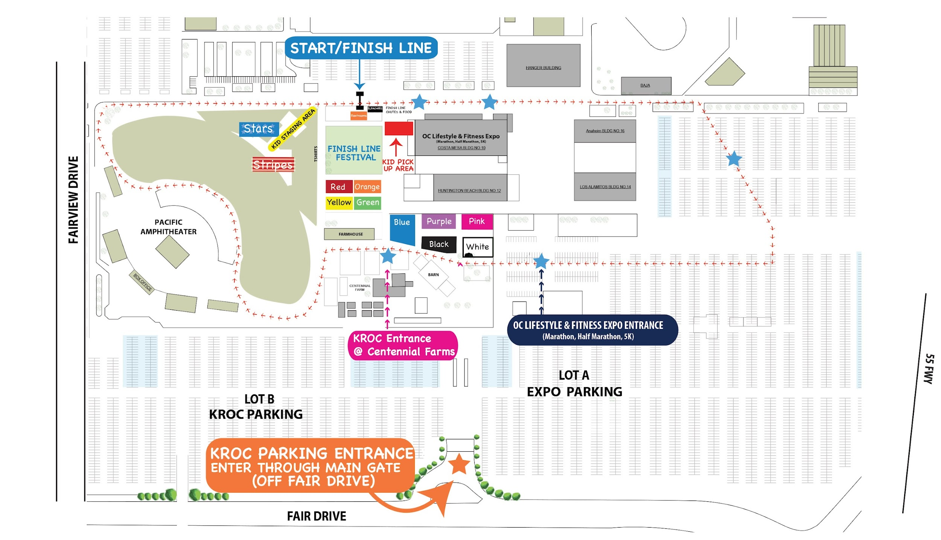
EVENT DAY
Kids Run the OC Event Day Information can be found at www.kidsruntheoc.org. Please check regularly as it changes and is updated frequently.
[Insert Team Name] Coaches will receive detailed information on parking, maps, heat times, etc. from The OC Marathon Foundation Staff. We will have an Event Day Parent Meeting on [Insert Date and Time] to go over event day information and answer any last minute questions you may have.
The OC Marathon Foundation always needs volunteers, please let a coach know if you are interested in volunteering for Kids Run the OC on Event Day.
2024 Event Details:
Location: The OC Fair & Event Center at 88 Fair Dr. in Costa Mesa
Date: May 4th, 2024
Time: See next slide for details
Notes:
Presenter: Gary
Main Ideas:
Use the Debrief in form of questions
Did you – Have Fun? Get MVPA? Reinforce Motor Skills?

Slide 17
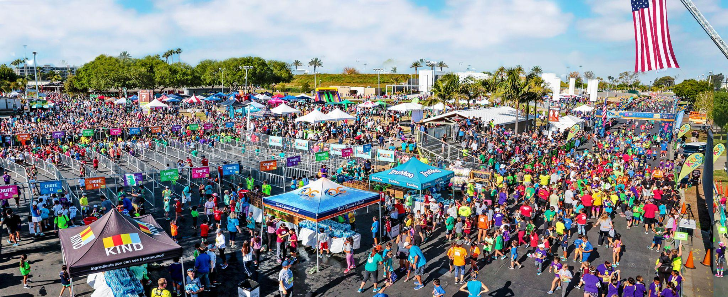
EVENT DAY (CONT.)
NOTE: Kids will run with their designated age group. Any participant running in a heat that is not within 1 year of their age on race day will not receive a time.
HEAT SCHEDULE (MAY 4, 2024):
8:00 AM: Open Heat #1 (9+)
8:30 AM: Open Heat #2 (8 & under)
9:00 AM: 11 & up
9:30 AM: 10 year olds
10:00 AM: 9 year olds
10:30 AM: 8 year olds
11:00 AM: 7 year olds
11:30 AM: 6 & under
Notes:
Presenter: Gary

Slide 18
THANK YOU!
Thank you for being a part of our program. It is such a rewarding experience watching each of them grow athletically and socially. We hope you will decide to stay a part of our family until your child graduates.
Here's to 2024!
Notes:
Adrienne
Show website for kids registration -- Done after the flyers are passed out
Kids show up for practice --- Make sure they are registered – Show them how to Use login -- hand out to explain on line management
Example of Waiver in packet which should be signed by every student
Coaches pick up Bibs at Event Day training – Dates to follow during Key Dates section

